Slide 1
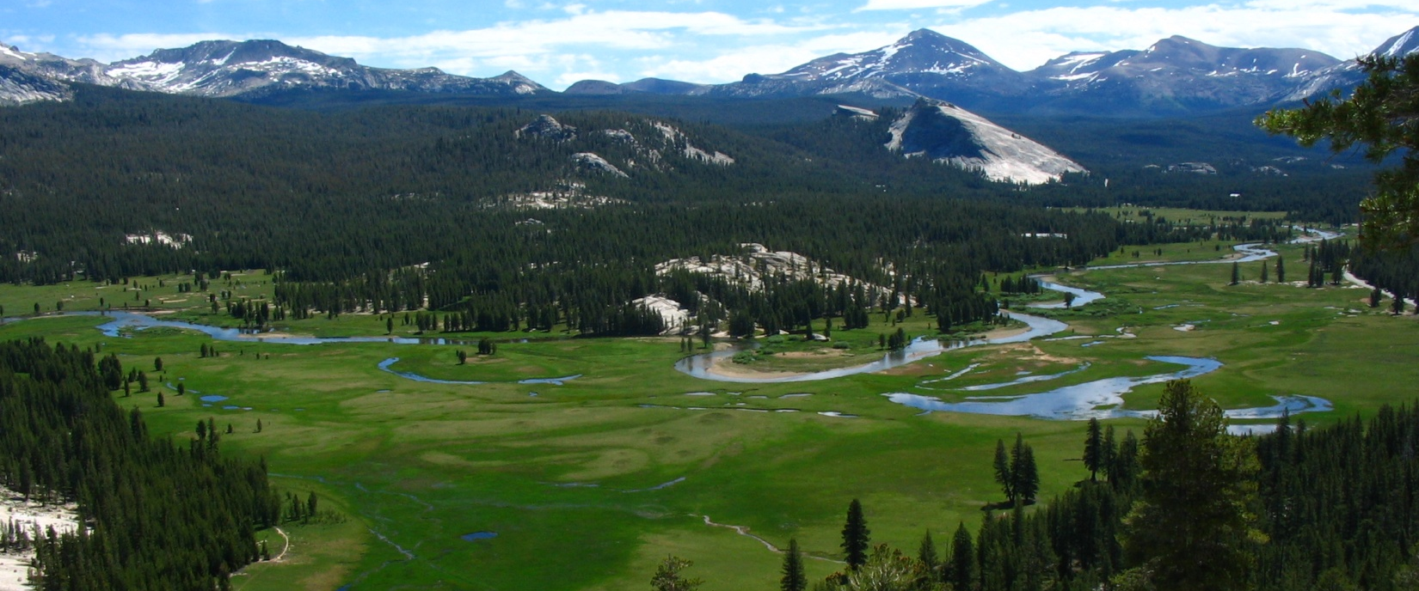
Guide to Tuolumne River Stream Data Yosemite, California
Water Years 2002 to 2015
Published 2016
Jessica Lundquist
Gwyn Perry, Eric Keenan
Civil and Environmental Engineering, University of Washington
Harrison Forrester, Jim Roche
Yosemite National Park

Slide 2
Table of Contents
Overview map 3
Instruments and Installations 4
Processing Steps for Stage 6
Data Types 9
Rating Curve Process 10
Photos, Cross-sections, Rating curves by site (UW sites)
Lyell Fork Below Maclure 13
Lyell Fork Above Twin Bridges 18
Lyell Fork Below Twin Bridges 24
Dana Fork at the Lodge 28
Dana Fork at Bug Camp 32
Tuolumne at Highway 120 37
Delaney Creek 44
Budd Creek 48
Info on Other Stream Sites
Grand Canyon of the Tuolumne NA
Falls Creek NA
Tuolumne at Hetch Hetchy NA

Slide 3
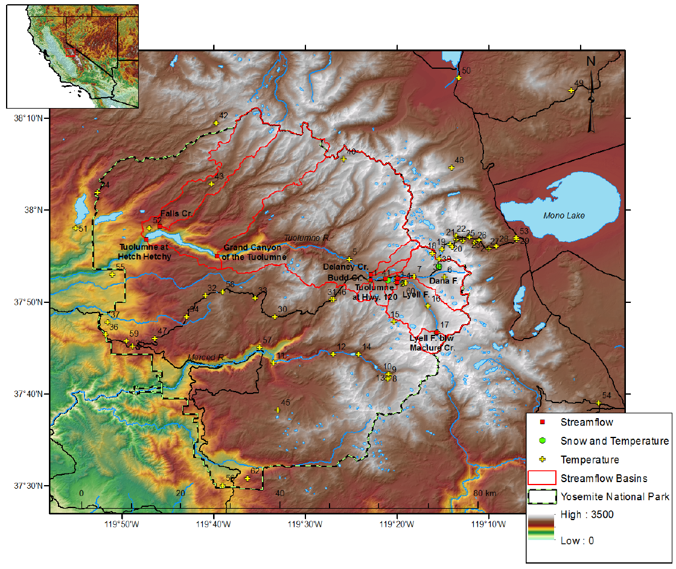
Overview of Yosemite Hydroclimate Dataset
Nested streamflow data for Tuolumne contributing to Hetch Hetchy (the ASO LiDAR domain)
Full met data to force a hydro model
Distributed temperature data from Lundquist and Cayan 2007

Slide 4
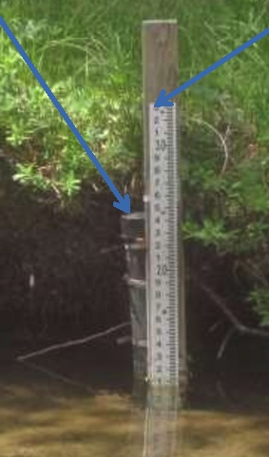
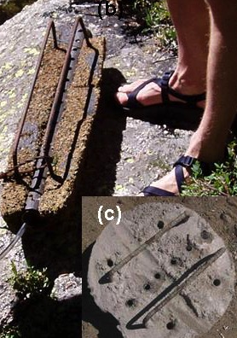
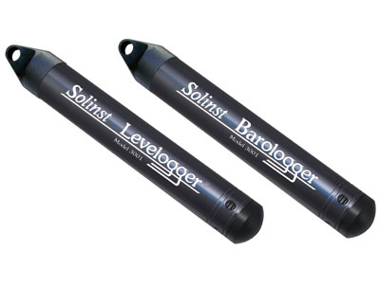
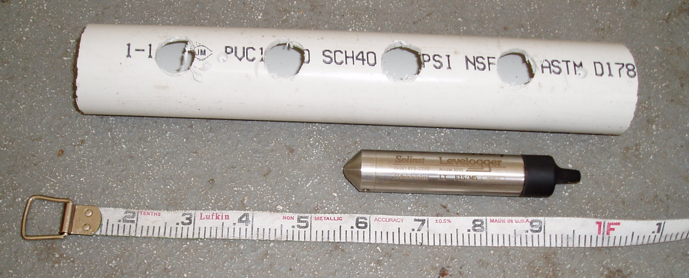
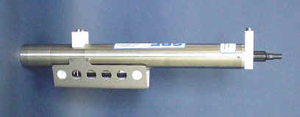
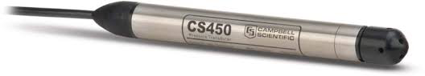
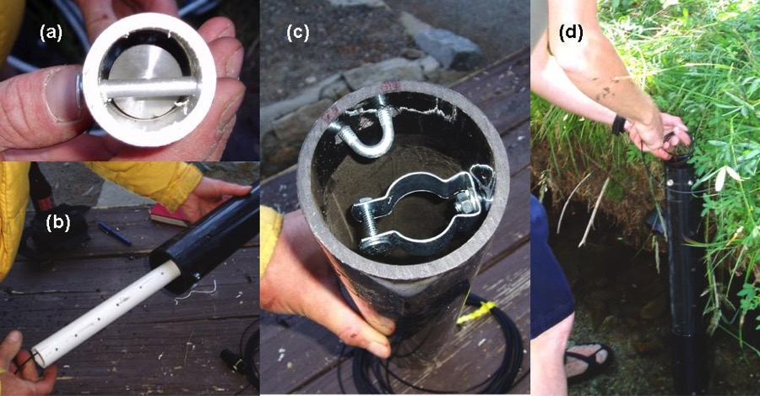
Instruments and Installations
Brief History of “Wilderness Stream Gauging”
Staff plate
Stilling tube
Aug 2005: Switch to wilderness stilling tube
Aug 2001: Solinst and Seabird in anchors
2015: Most sites upgraded to vented pressure transducer

Slide 5
Installation Type | Anchored Solinst | Solinst in Stilling Tube | Vented Pressure Transducer
Description | Instrument in a PVC pipe inside a concrete anchor, which is cabled to a tree, bridge, or culvert. | Instrument in PVC pipe inserted in vertical pipe attached to the streambed and bank with rebar; with cord for downloading instrument. | Same as stilling tube but with data cord connected to a data logger box (typically hidden in a tree) and another cord open to the atmosphere.
Instrument Used | Solinst Levelogger | Solinst Levelogger | Druck¹ Or Campbell Scientific CS450 PT²
Instrument Specs/Accuracy | Levelogger Model 3001: 0.1°C temp accuracy, ±0.5 cm pressure/depth accuracy; temperature compensated over the range of -10 to 40°C; drift of 0.1% of the full range (±0.5 cm for a 5 m model, used here). | Levelogger Edge and Gold: Temp accuracy ± 0.05°C Pressure ± 0.05% of FS (for 5 m model, this would be ±0.25 cm); Manufacturer states clock accurate to 1 minute per year, but 20 minutes of drift per year was typically observed | Druck: 0-5 PSI Range, 0.25% accuracy; CS450: 0-7.25 PSI Range, 0.1% accuracy;
Processing steps required | 1) subtract off atmospheric pressure; 2) correct for offsets in instrument location; 3) check for instrument drift; 4) develop rating curve | 1, 3, and 4 | 3 and 4
Total error estimates in stage (Note that these are worst case scenarios) | Up to ± 3 to 4 cm, with ± 2 cm due to summed instrument accuracy and drift for both stream and barometric instruments; and ± 1 to 2 cm more due to uncertainty in instrument location | Up to ± 2 cm due to summed instrument accuracy and potential drift for both stream and barometric instruments | Up to ± 0.5 cm due to summed instrument accuracy and potential drift
Error in estimated discharge* | ± 0.92 m³ s⁻¹ to ± 1.24 m³ s⁻¹ (14-19%) | ± 0.61 m³ s⁻¹ (9%) | ± 0.15 m³ s⁻¹ (2%)
*Using Lyell Fork Twin Bridges summer flow, 0.7 m stage, as an example

Slide 6
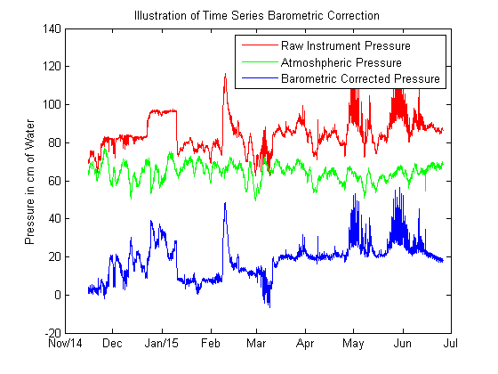
Processing Steps for Stage
1. Subtract off atmospheric pressure (example from Dana Fork Bug Camp)
Atmospheric pressure (the green line) is subtracted from the raw instrument pressure (the red line) to obtain pressure due to water overlying the instrument (the blue line).

Slide 7
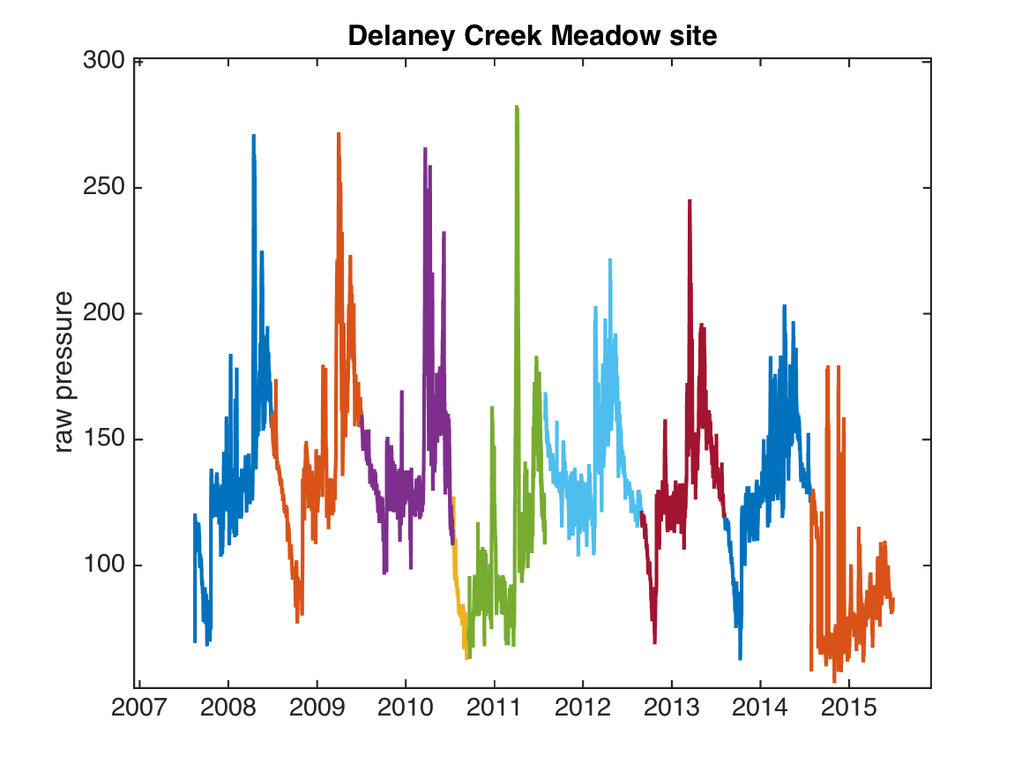
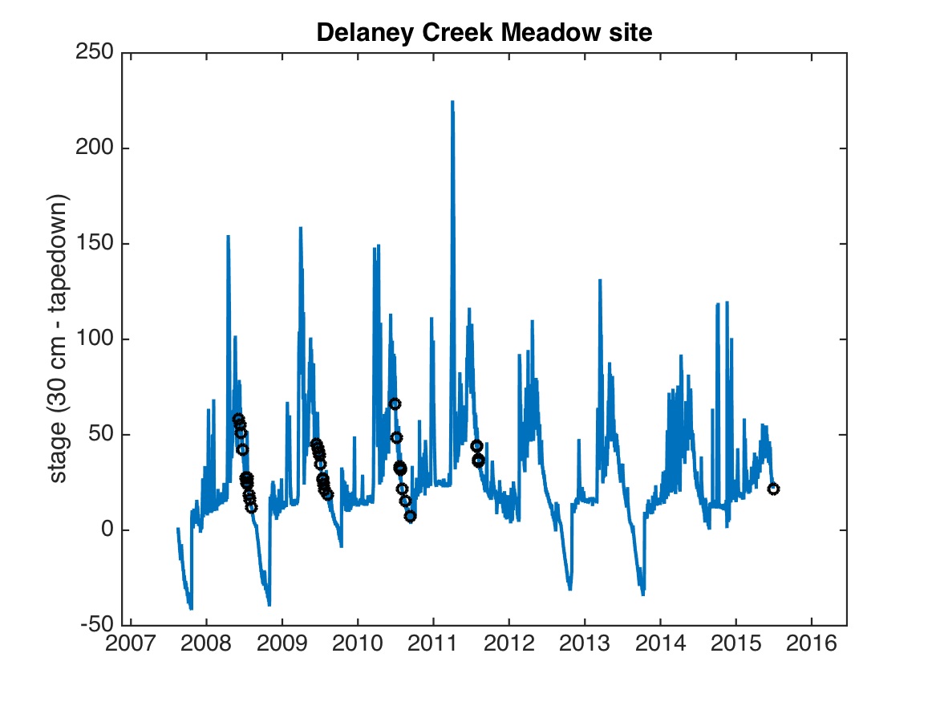
Processing Steps for Stage
2 & 3. Correct for offsets in instrument location and check for instrument drift (example from Delaney Creek)
Raw pressure from multiple years (each color represents a different instrument) illustrates how offsets are often required when instruments are replaced.
Raw pressure data
Manual stage measurements (black circles) provide guidance for offsets to adjust the barometrically-corrected water pressure values.
Stage = barocorrected pressure + offset

Slide 8
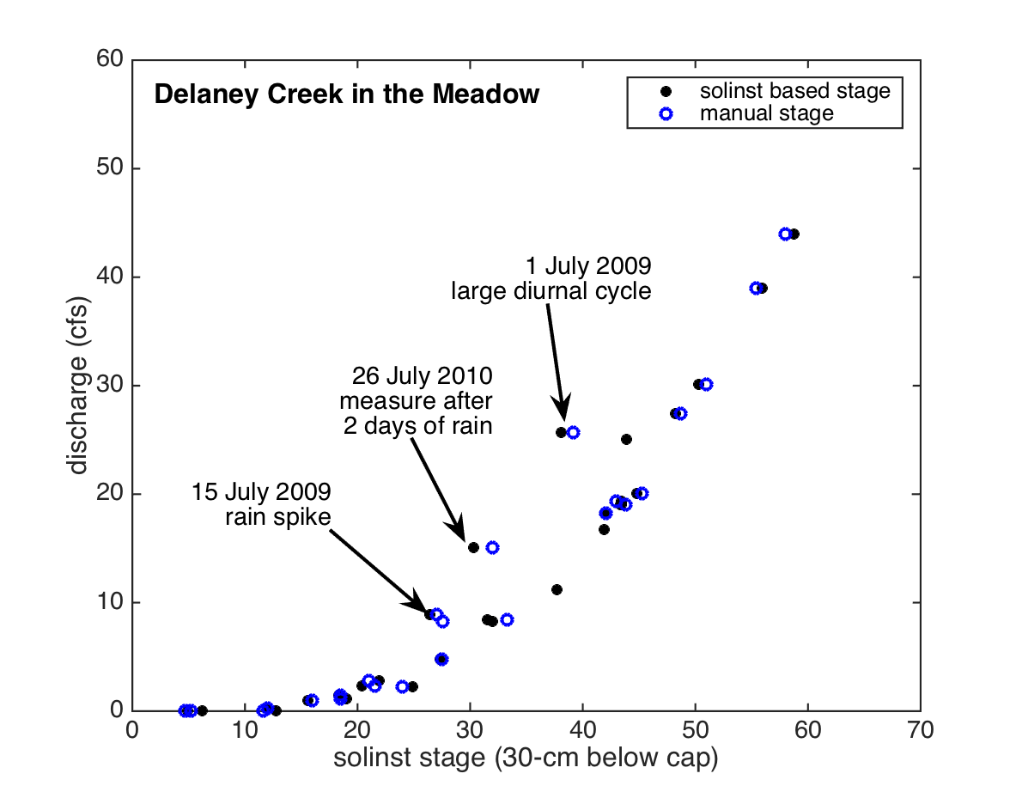
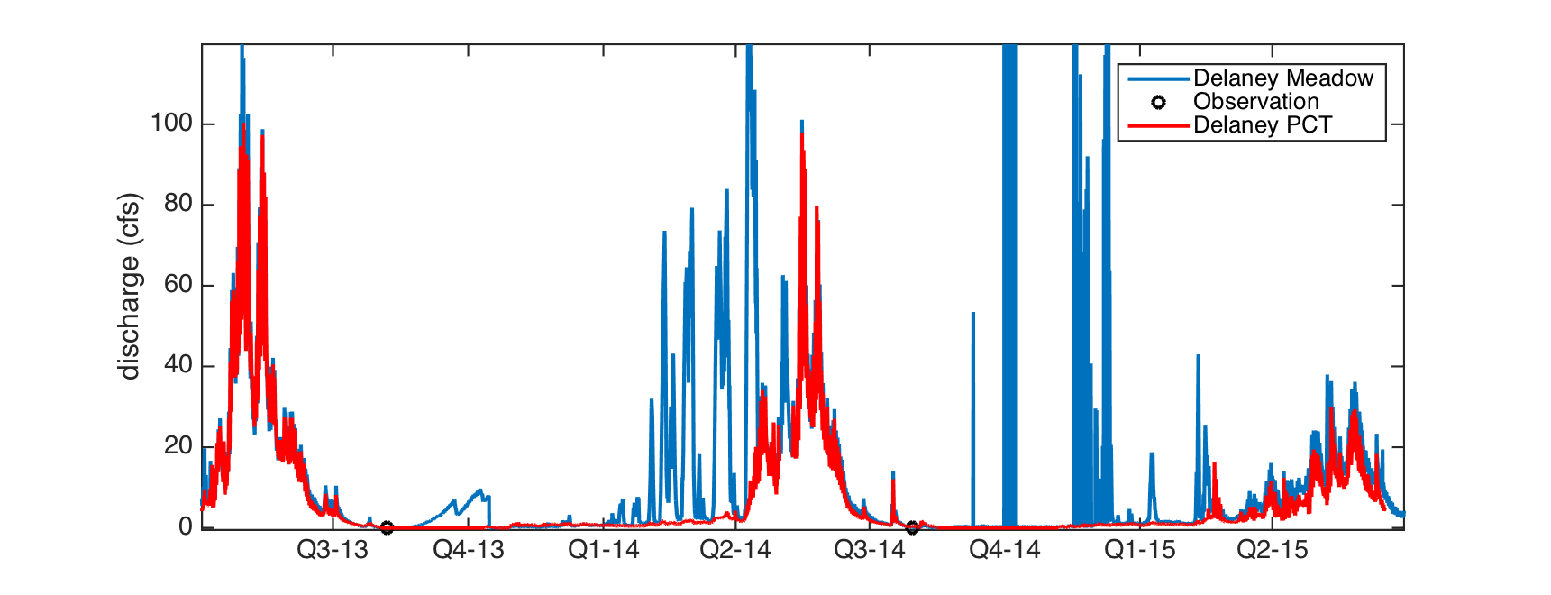
Processing Steps for Stage
4. Develop rating curve (example from Delaney Creek)
Measurements used to create rating curve (note 3 outliers marked here were not used)
Discharge timeseries: Blue is meadow record provided here; Red is independently generated record from slightly upstream.
Meadow (blue) is prone to ice jams.

Slide 9
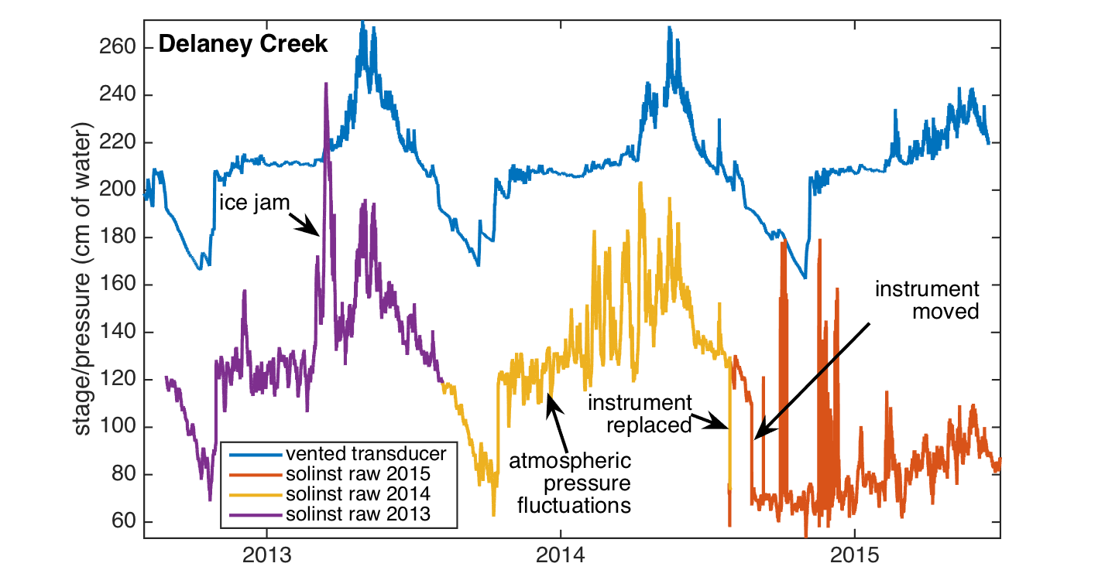
Data Types:
Raw data: pressure recording, including both weight of water in stream and atmosphere; pieced together from multiple instruments to create continuous record in the water
Baro-corrected data: Atmospheric pressure subtracted off the raw timeseries
Offset: Added to baro-corrected data to eliminate times when instrument moved and when different instruments had different local biases: corrected to match stage datum when and where available
Stage from instrument (in manual measurement files): This is baro-corrected data + offset. Used to create rating curve.

Slide 10
Rating Curve Development
Pre-process manual data (as shown above)
Include 10% uncertainty in discharge
Develop prior rating curve parameters from survey data, with substantial uncertainty values, using BaRatin (Le Coz et al. 2014), to fit the form Q=a(h - b)^{c}
Section Control: low flow acts like a rectangular weir
Inputs for determining prior “a” =
Discharge Coefficient (C_{r}): default = 0.4 ± 0.05
Width of “weir”, perpendicular to flow direction (B_{r})
Inputs for determining prior “b”
Average elevation of “weir” crest
Inputs for determining prior “c”
Default: 1.5 ± 0.05
Channel Control: mid flow acts like a rectangular channel, use the Manning–Strickler equation
Inputs for determining prior “a” =
Slope of channel bed (S_{e})
Channel width (B)
Roughness coefficient (K_{s}): 20 ± 5 for all channels to be conservative
Inputs for determining prior “b”
Average elevation of Channel bottom
Inputs for determining prior “c”
Default: 1.67 ± 0.05
Channel + Floodplain Control: high flow acts like the sum of the channel and floodplain (sum of 2 channel controls)

Slide 11
Rating Curve Development (continued)
Use the BaRatin MCMC routine (see LeCoz et al. 2014 and references therein) to use manual stage and discharge observations, along with their estimated uncertainty (10%), to determine the posterior rating curve parameters and control segment breaks to fit the following piecewise power function:
Where N_{range} is the number of stage ranges
N_{control} is the number of hydraulic controls
K_{r} is the upper water level at stage range r
M is the hydraulic control matric (M(r,j) = 1 if hydraulic control j is active in stage range r
h is stage
a, b, and c are the fitted parameters for stage range j
Outputs include the rating curve equation for each stage range, as well as a look up table of values for the upper and lower limits of 95% confidence intervals (which vary by stage and are determined as part of the MCMC process)
These are illustrated for each site in the pages that follow.
For comparison, a single equation of the form Q=a(h - b)^{c} was also calculated for each site using transformed least squares (Rantz et al. 1982), and this equation and its 95% confidence intervals are also shown

Slide 12
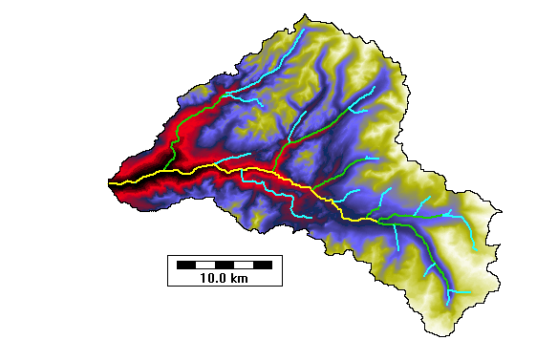
Specific Sites:
Delaney Creek
Dana Fork of the Tuolumne River
Tuolumne River at Highway 120
Lyell Fork of the Tuolumne River
Lyell Fork below Maclure

Slide 13
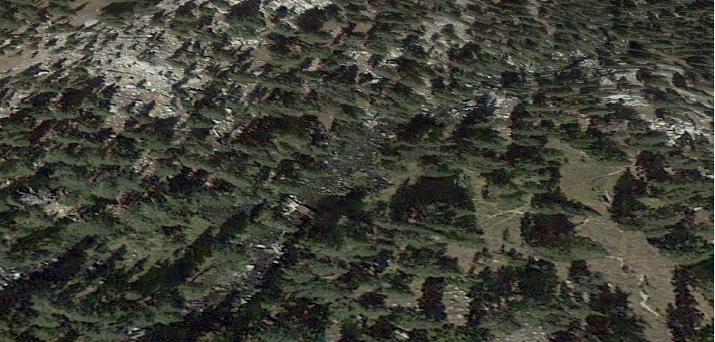
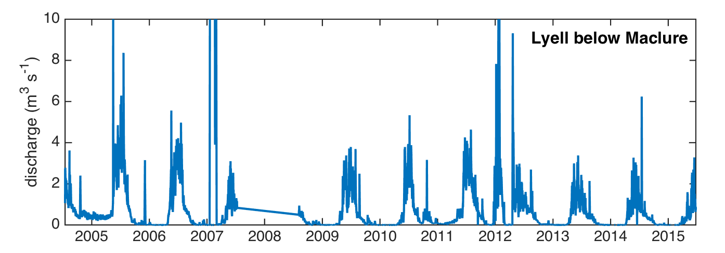
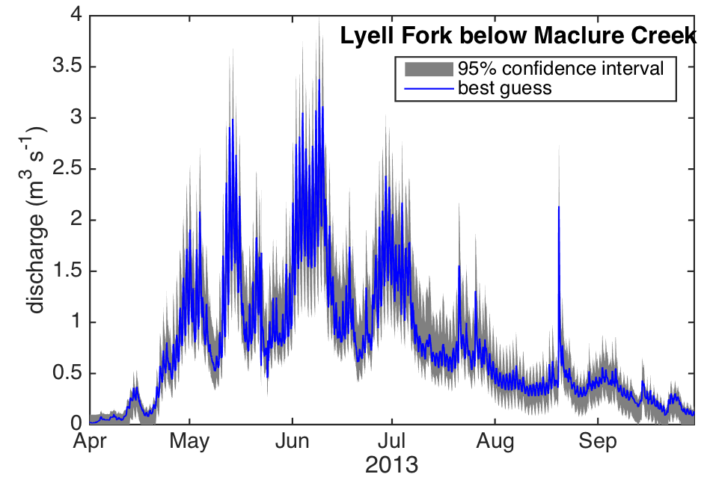
Lyell Fork below Maclure
40 m
control
JMT/PCT Bridge
site
(stilling tube)
ice jams
Overall, rating curve is good, but there is greater uncertainty in the datum before 2008, and there are occasional ice jams.

Slide 14
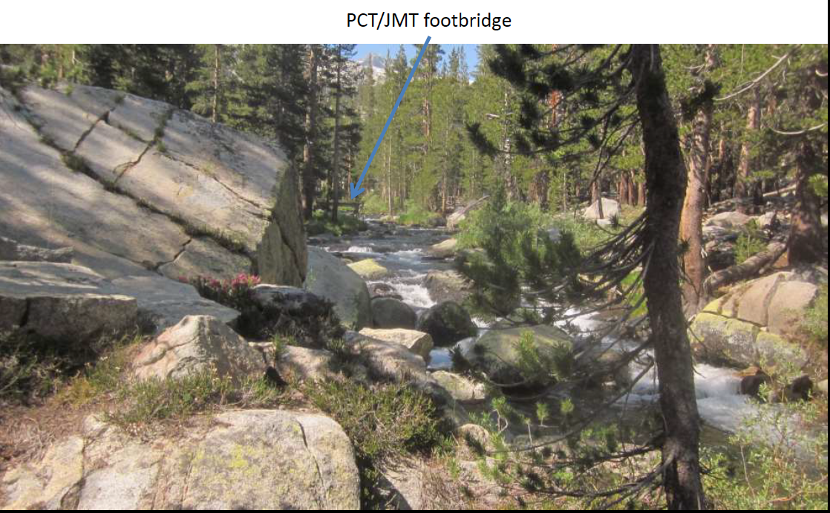
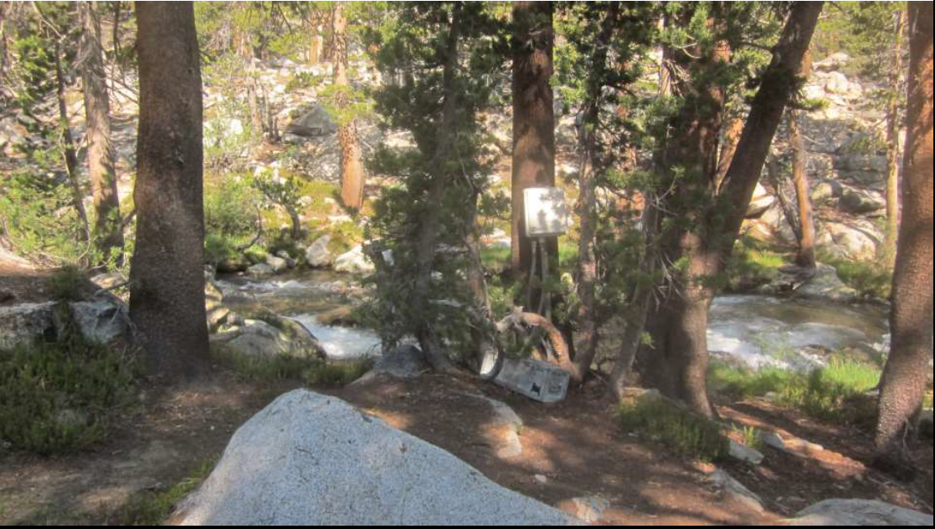
Lyell Fork below Maclure
Latitude: 37.777
Longitude: -119.261
Datum: NAD83
Elevation: 2940 m
View upstream from instrument
Flow
Instrument location

Slide 15
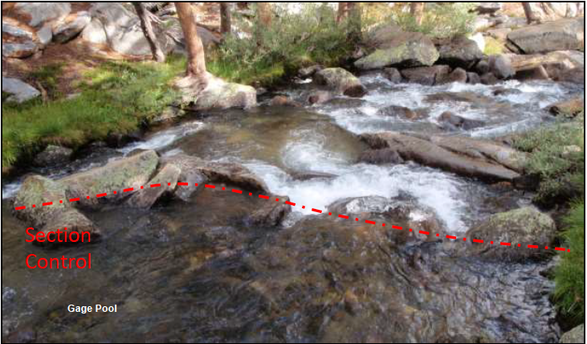
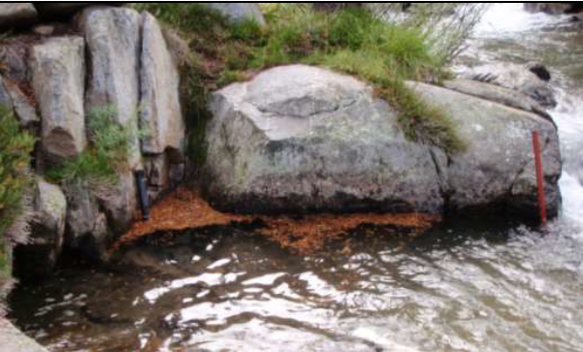
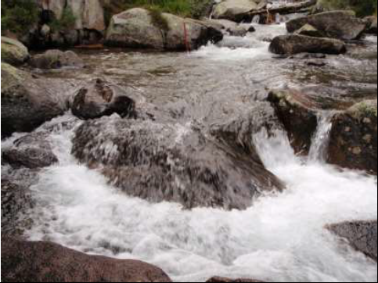
Lyell Fork below Maclure Creek
Based on photographs estimate two cross-sections:
Channel Control
Width: 6 m +- 2 m
Slope: 0.04 +- 0.02
Section Control
Width: 3 m +- 3 m (unknown cross-section)
Height of control break: 3 m +- 3 m (unknown cross-section, maximum depth measured is 6 m)

Slide 16
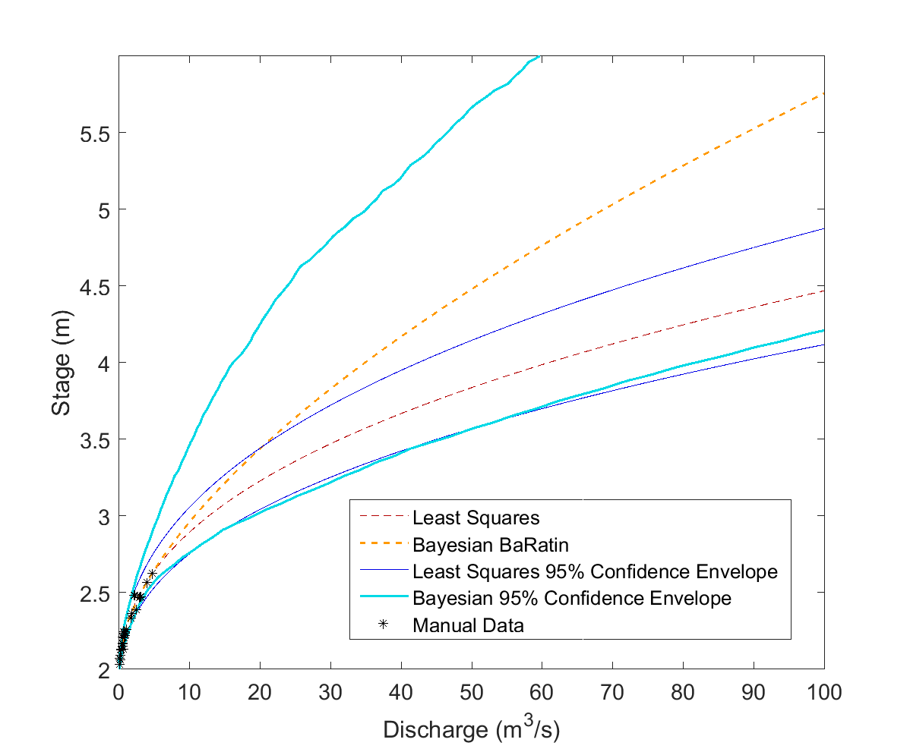
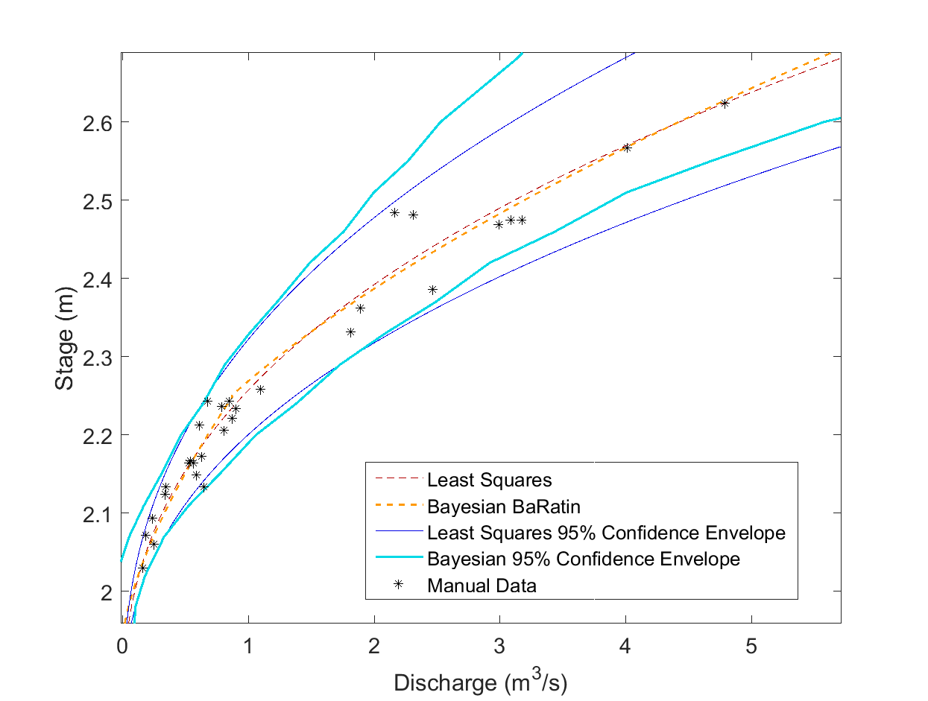
Lyell Fork below Maclure Creek
Least Squares (stage in ft, Q in cfs):
Q = 14.9123*(H – 6)^2.5323
BaRatin (stage in m, Q in cms):
2.25m < H <= 6.044m
Q = 11.609*(H –2.0443)^1.6415
H <2.25
Q =4.9324*(H – 1.9357)^1.4917
Posterior Height of Section Break between Section Control and Channel Control: 2.25 m
Posterior Height of Section Break between Section Control and Channel Control: 2.25 m

Slide 17
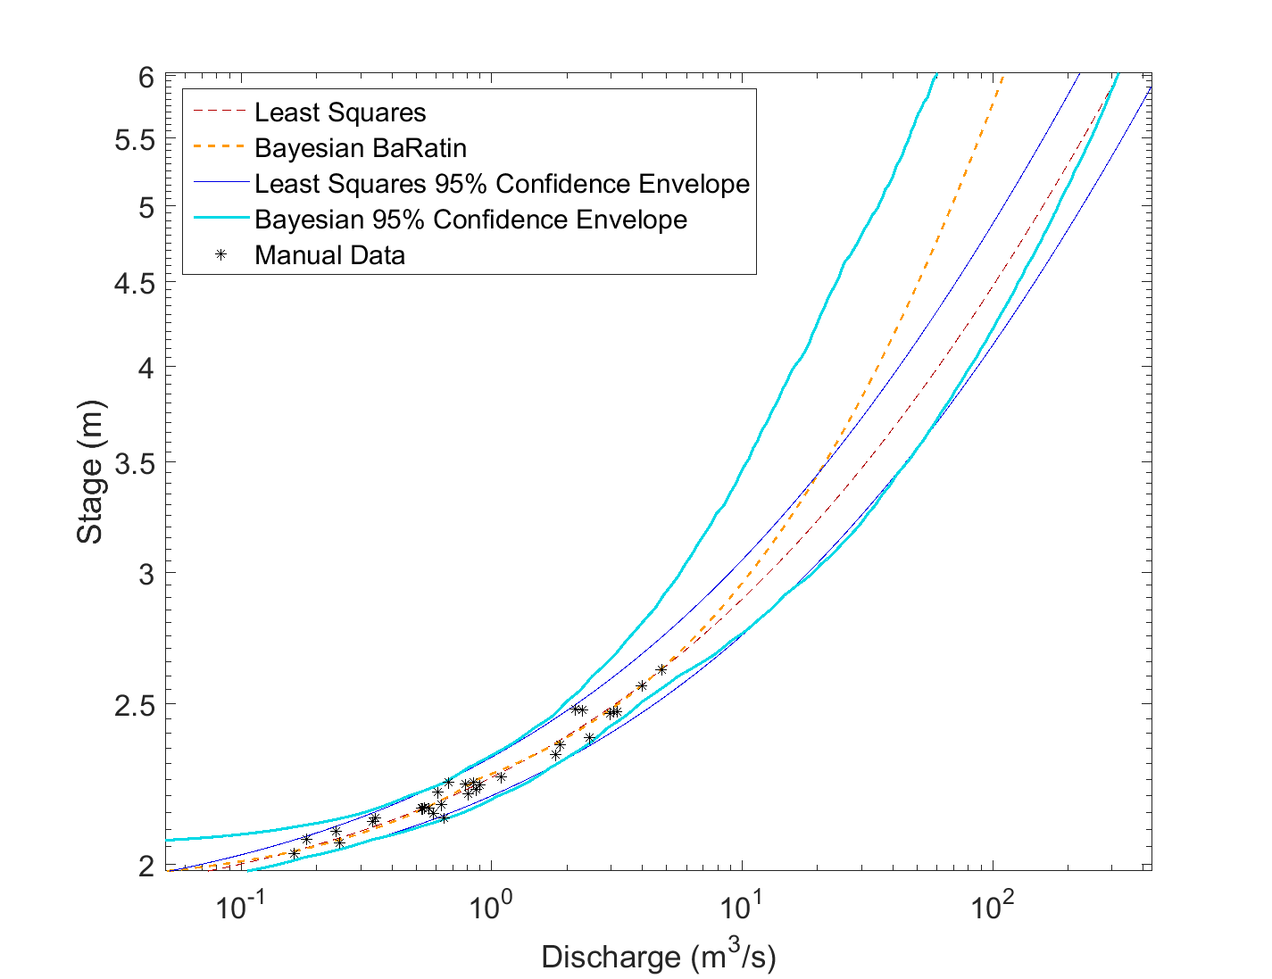
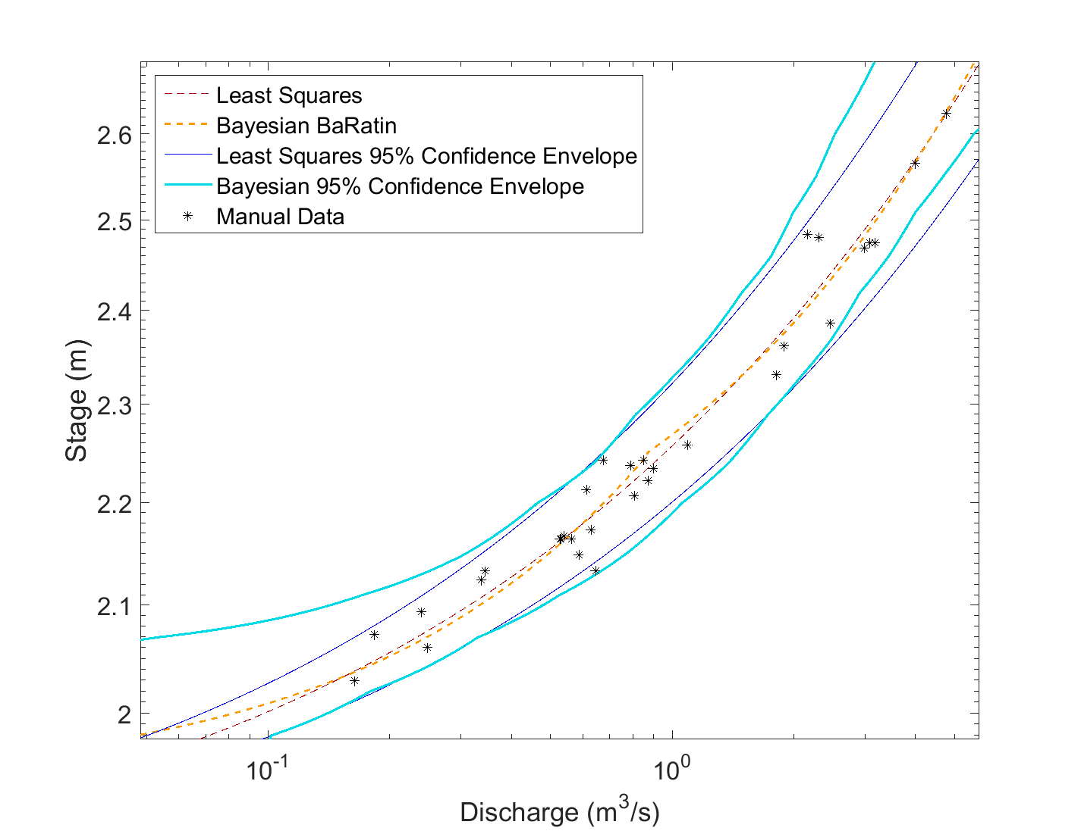
Log-Log View
Lyell Fork below Maclure Creek
Posterior Height of Section Break between Section Control and Channel Control: 2.25 m
Posterior Height of Section Break between Section Control and Channel Control: 2.25 m

Slide 18
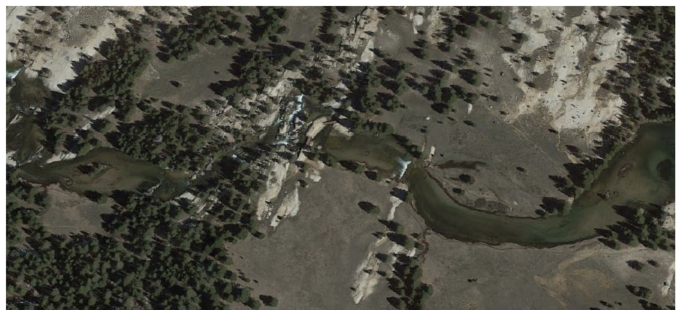
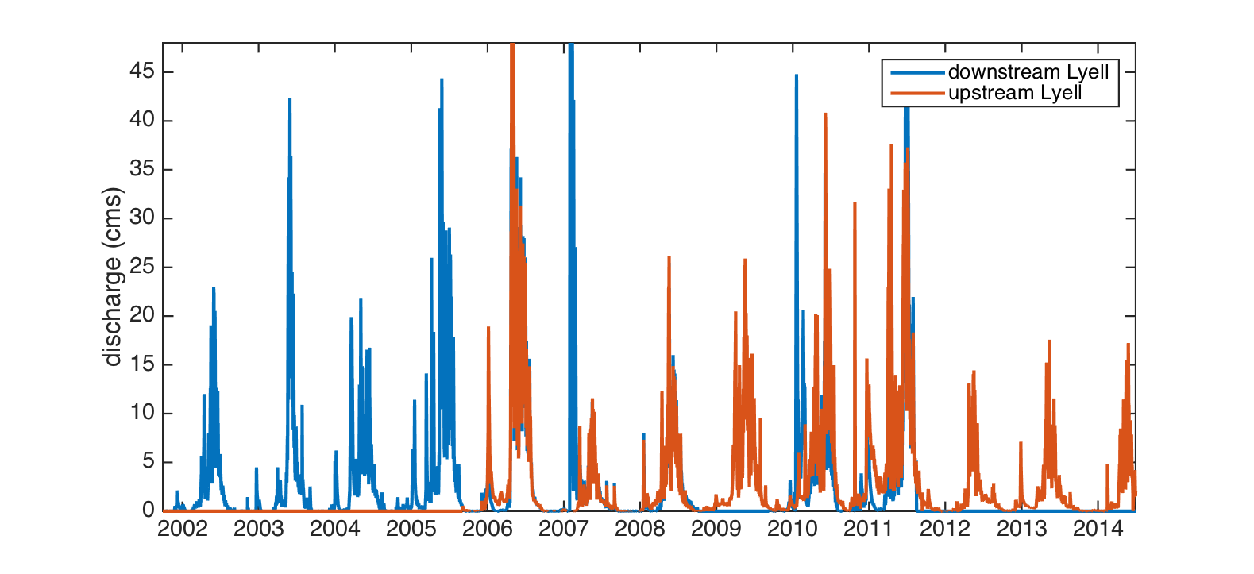
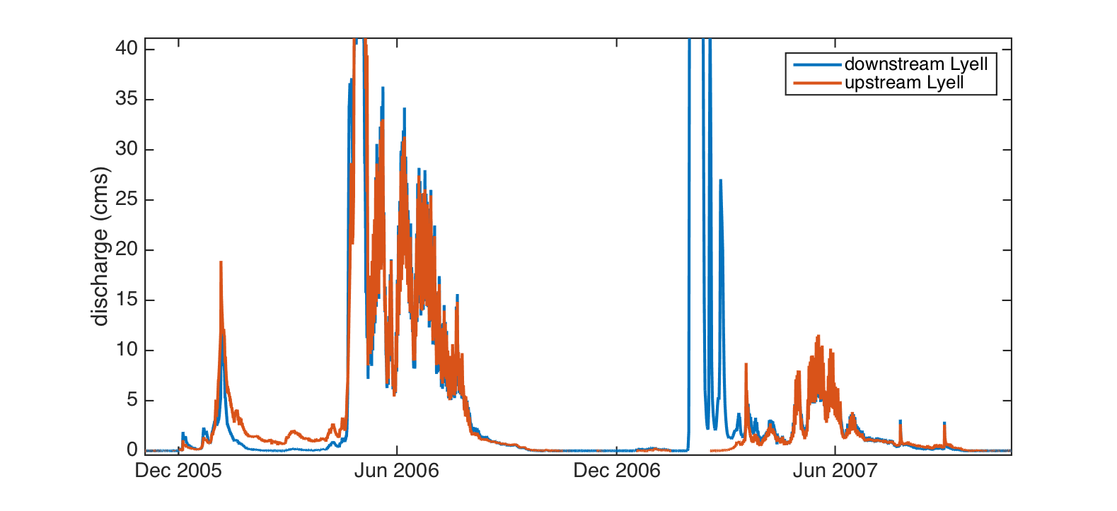
Lyell Fork at Twin Bridges
Latitude: 37.869
Longitude: -119.331
Datum: NAD83
Elevation: 2640 m
100 m
Twin Bridges
Lower site
(anchor)
Bedrock control
Upper site
(stilling tube)
The downstream site was installed first (WY 2002), with the upstream site designed to replace it starting WY 2006. Calculated discharge agrees very well during the 2006-08 period of overlap, with the exception of winter and early spring ice jams. For 2009 on, the downstream site was less frequently maintained, and the upstream site record should be used.
Downstream site was subject to ice jams

Slide 19
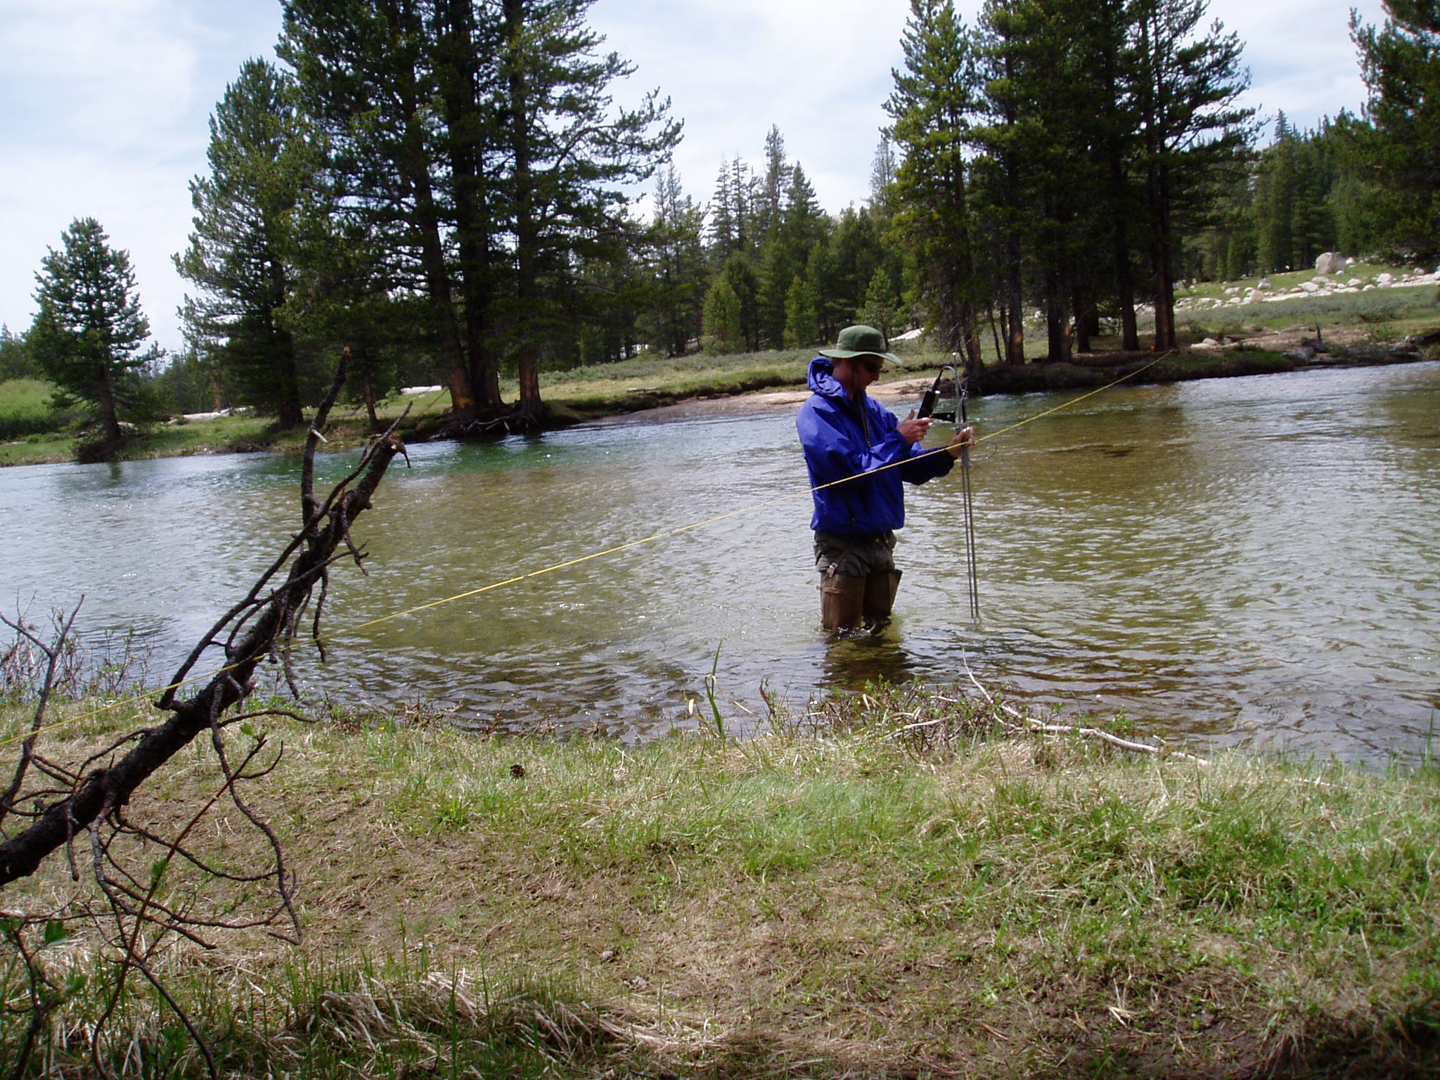
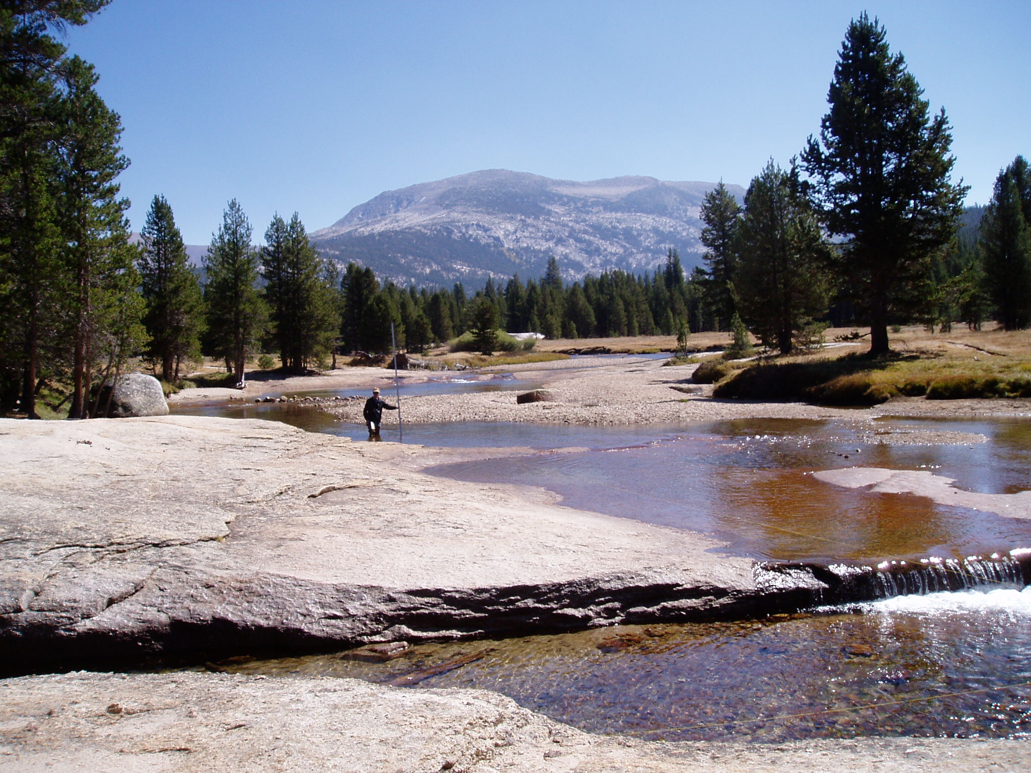
Lyell Fork abv Twin Bridges
Latitude: 37.869
Longitude: -119.331
Datum: NAD83
Elevation: 2640 m
Flow
Discharge measurement at bank full flow (18 June 2003)
Low flow control
Upstream instrument
Flow
Bedrock control

Slide 20
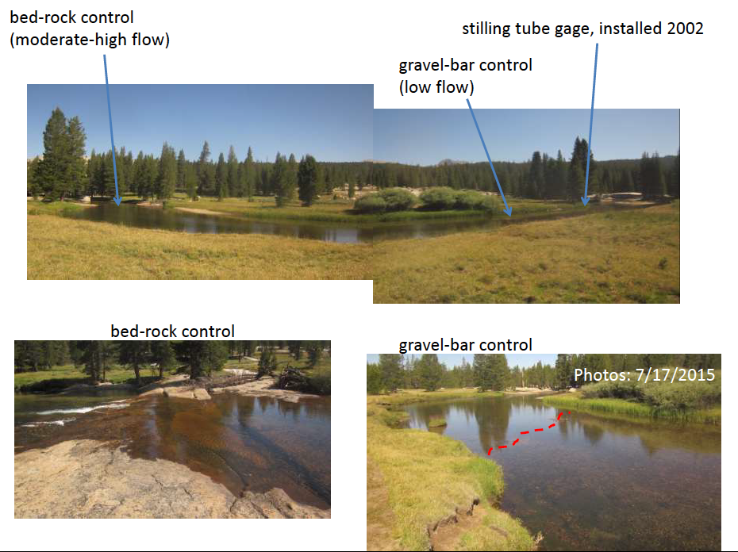
Lyell Fork above Twin Bridges
Note: On 17 July 2015 at 9:15 am local time, the depth of water over the bed-rock control was 0.68 ft and over the gravel-bar control was 1.50 ft. Gauge height measured as 10 ft – distance from top of stilling tube to water (0.78 ft) at that time was 9.22 ft; making gauge height 8.54 ft when bedrock control matters and 7.72 ft when gravel-bar control matters – need to check new references to my stage measurements. Stage reference has been hard here.

Slide 21
Lyell Fork above Twin Bridges
Cross-Section at Instrument Site with Stage Measurement Datum
River Right
Width used for Channel Control (used same width for floodplain): 25 m +- 5m
Height of Section Break between Channel Control and Floodplain/Channel Control: 0.8 m +- 0.2m
Width used for Section Control: 15 m +- 5m
Instrument
Height of Section Break between Section Control and Channel Control: 0.6 m +-0.2m
Note significantly different scales for x and y axes.
Floodplain
Slope: 0.0003 m/m
Instrument
Channel
Flow

Slide 22
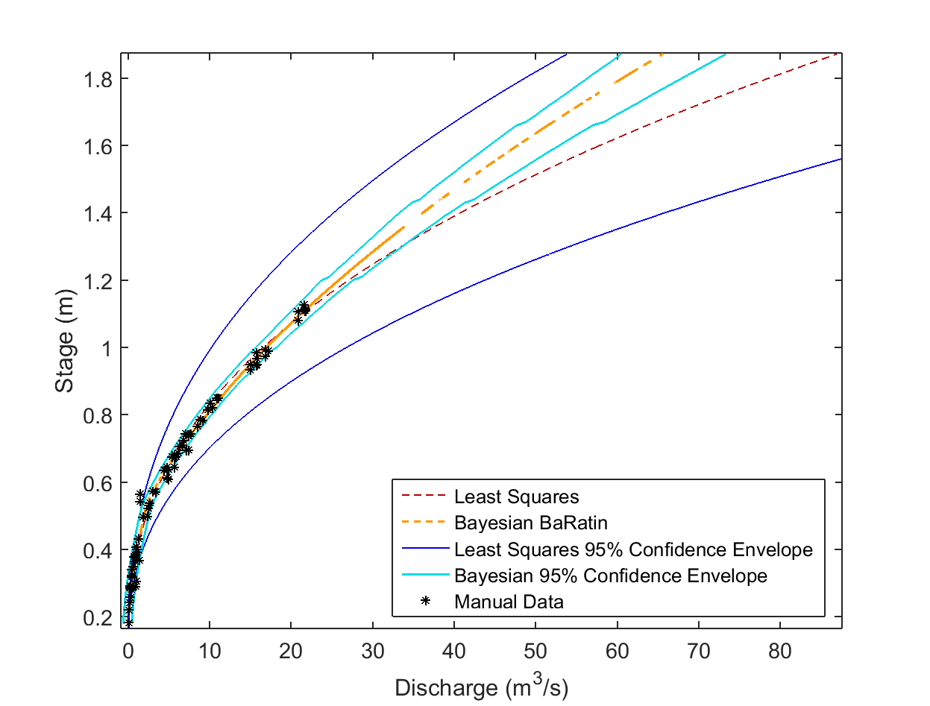
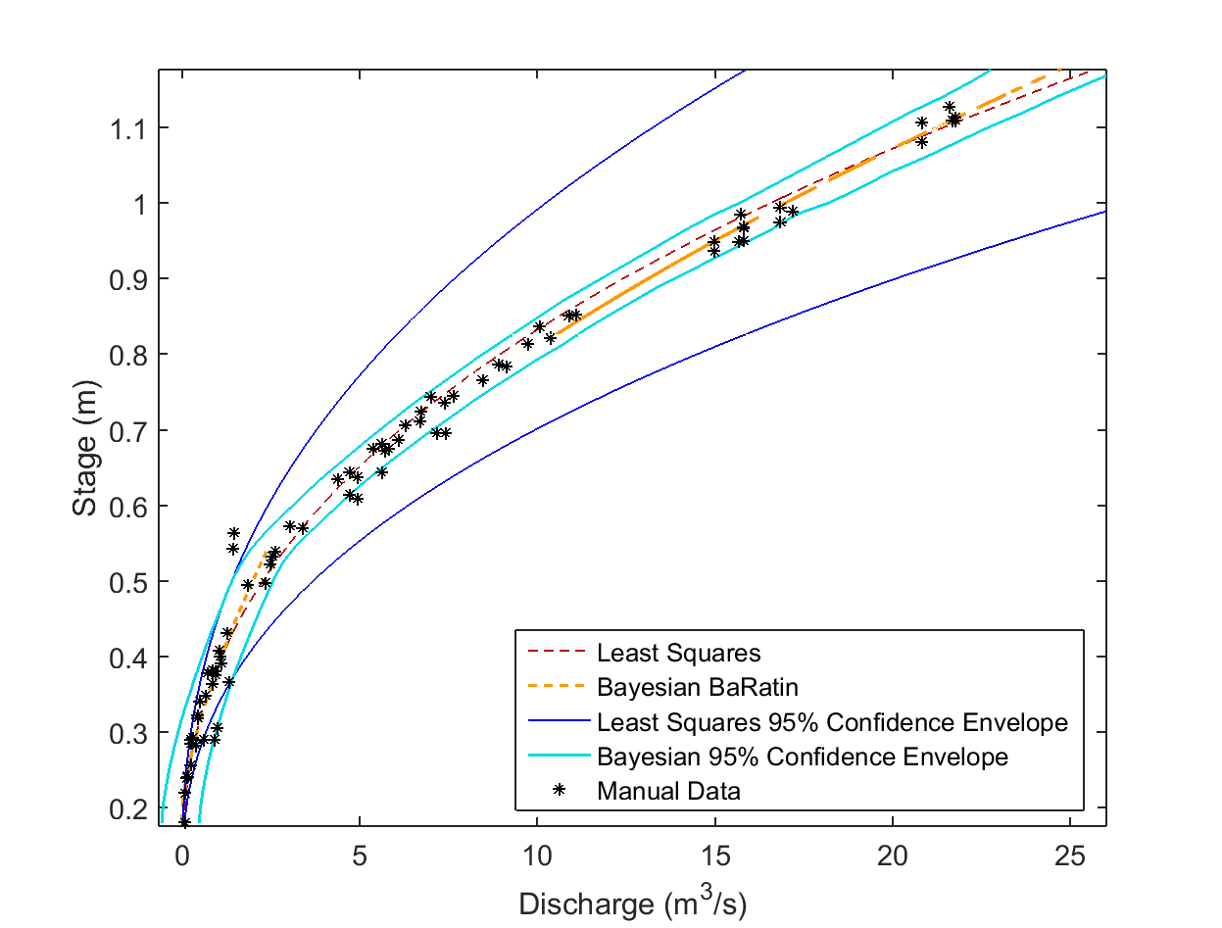
Lyell Fork above Twin Bridges
Least Squares (stage in cm, Q in cfs):
Q = 0.00965*(H – 10)^2.4474
BaRatin (stage in m, Q in cms):
0.79875m < H
Q =30.94*(H –0.3023)^1.6658
0.540748m < H < 0.79875m
Q =35.6095*(H – 0.343)^1.662
H < 0.540748m
Q =11.5733*(H –0.1873)^1.512
Posterior Height of Section Break between Channel Control and Floodplain/Channel Control: 0.80m
Posterior Height of Section Break between Section Control and Channel Control: 0.54 m
Posterior Height of Section Break between Channel Control and Floodplain/Channel Control: 0.8m
Posterior Height of Section Break between Section Control and Channel Control: 0.54 m

Slide 23
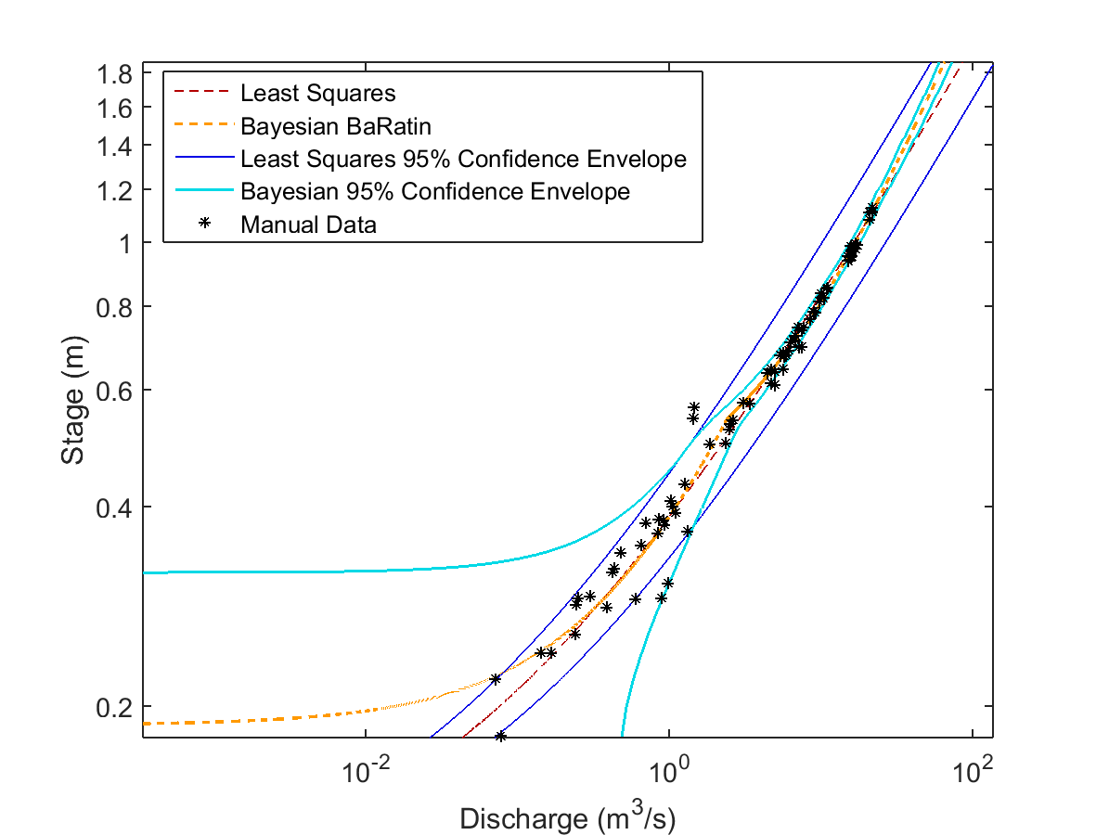
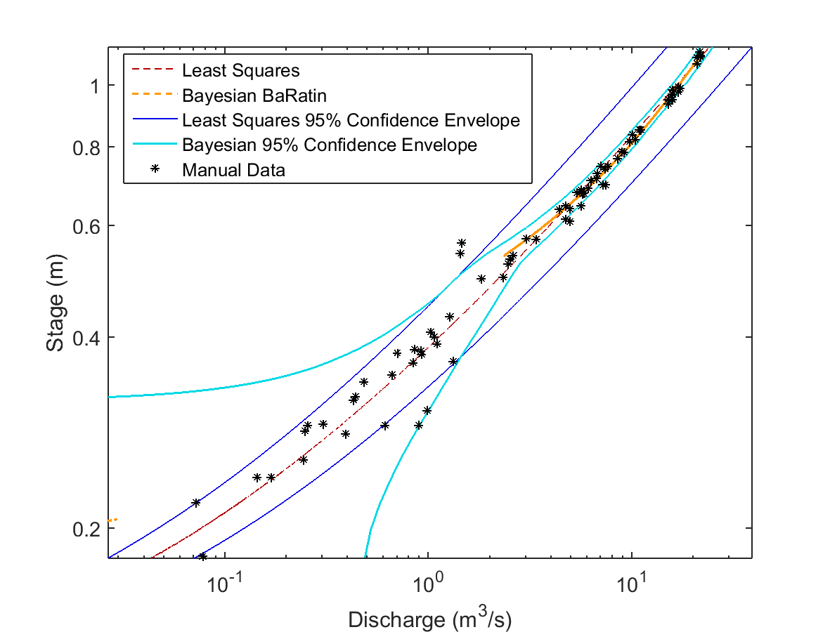
Log-Log View
Lyell Fork above Twin Bridges
Posterior Height of Section Break between Channel Control and Floodplain/Channel Control: 0.8 m
Posterior Height of Section Break between Section Control and Channel Control: 0.54 m
Posterior Height of Section Break between Channel Control and Floodplain/Channel Control: 0.8 m
Posterior Height of Section Break between Section Control and Channel Control: 0.54 m

Slide 24
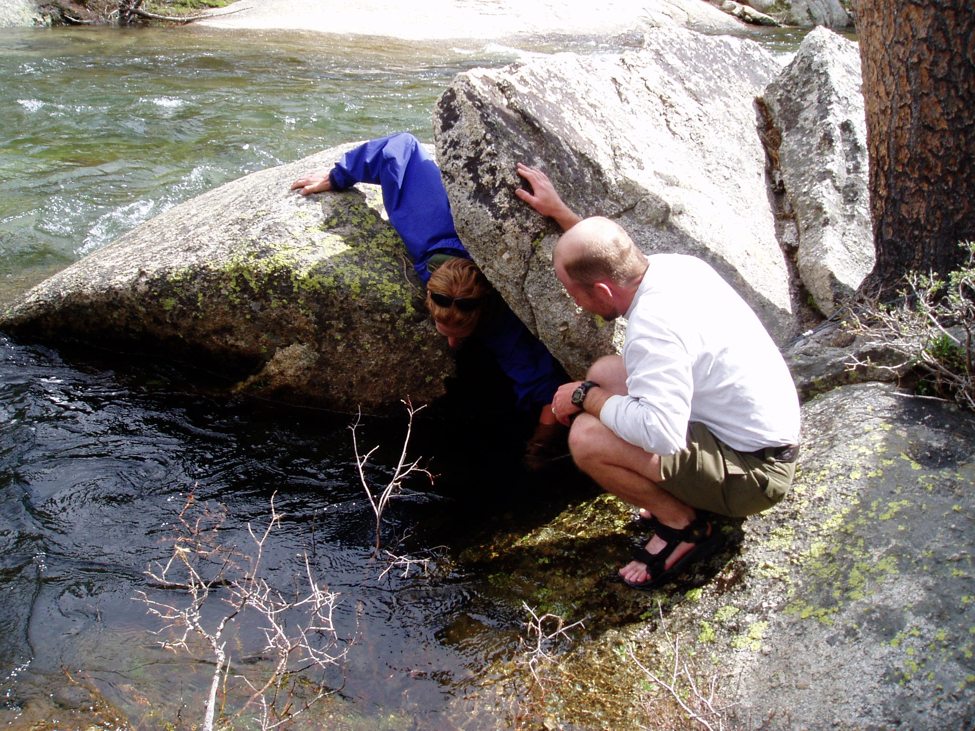
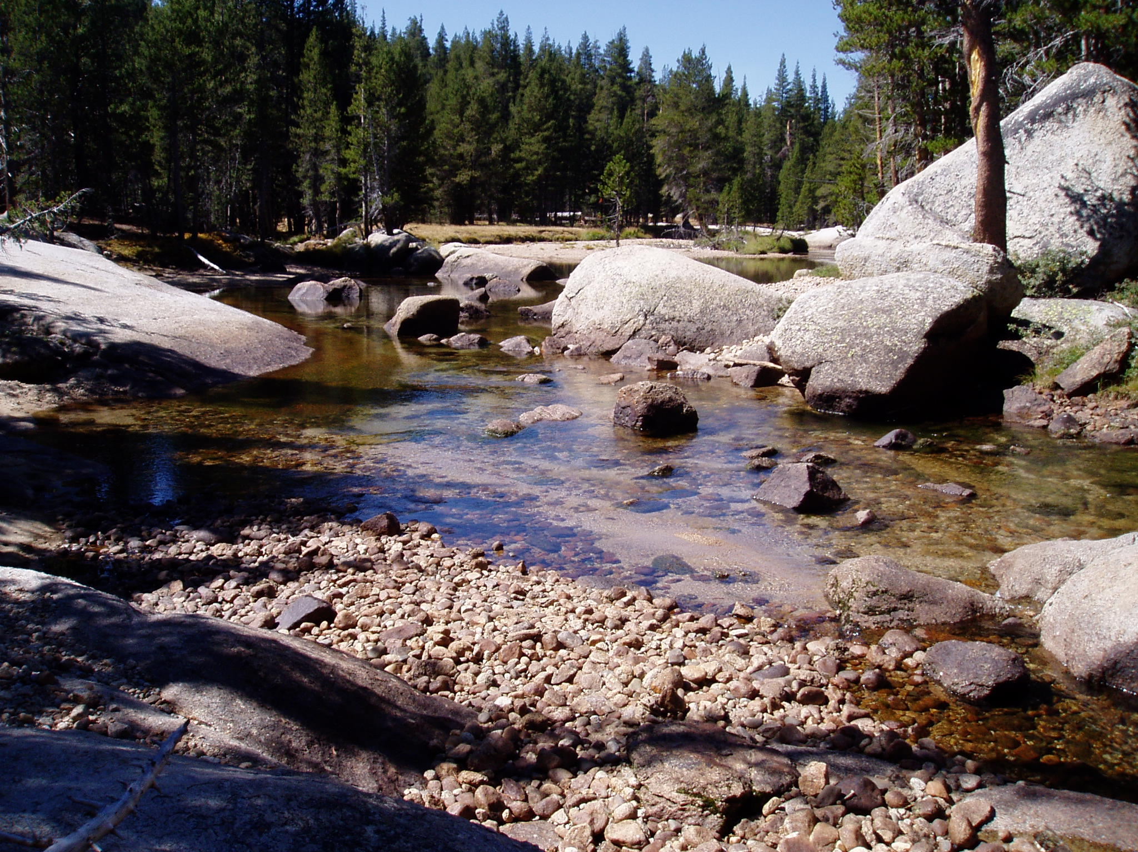
Lyell Fork blw Twin Bridges
Latitude: 37.869
Longitude: -119.331
Datum: NAD83
Elevation: 2640 m
Instrument

Slide 25
Lyell Fork below Twin Bridges
Note significantly different scales for x and y axes.
River Right
Width Used for Floodplain/Channel Control: 25 m +- 5m
Width used for Channel Control: 21 m +- 5
Height of Section Break between Channel Control and Floodplain/Channel Control: 2.55 m +- 0.2m
Width used for Section Control: 10 m +- 1m
Height of Section Break between Section Control and Channel Control: 0.91 m +- 0.2m
Instrument
Slope: 0.0111 m/m

Slide 26
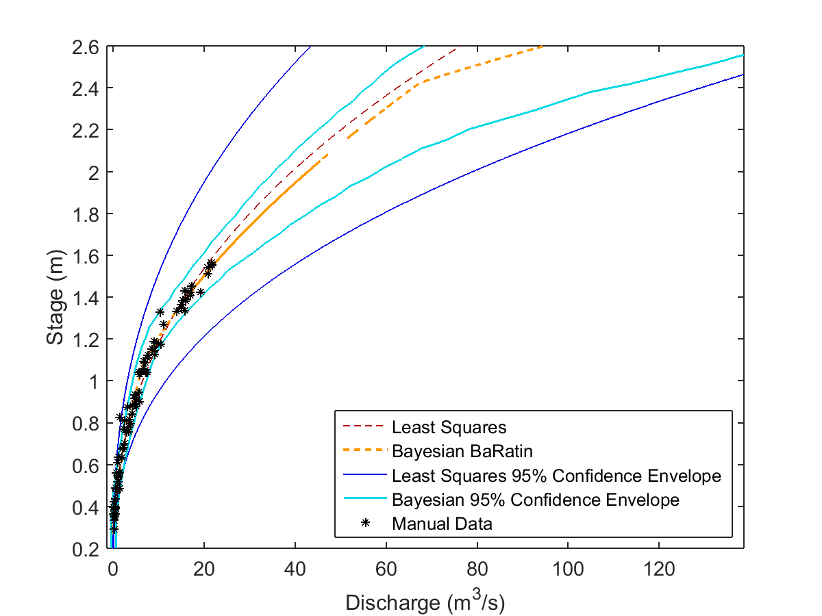
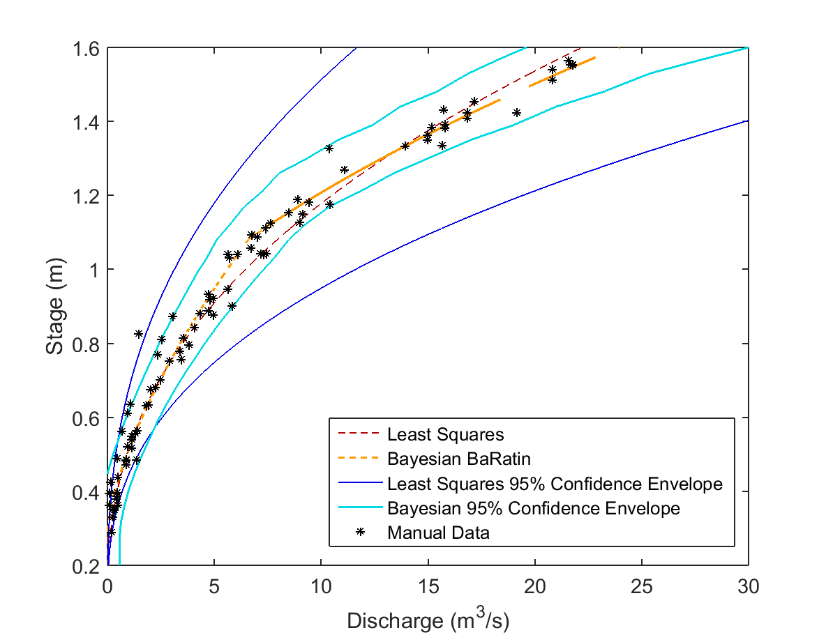
Lyell Fork below Twin Bridges
Height above which rating curve does not apply (ice jam): 2.5m
Least Squares (stage in cm, Q in cfs):
Q = 0.0043*(H – 10)^2.4177
BaRatin (stage in m, Q in cms):
2.425m < H <= 2.5m
Q = 103.003*(H –1.6484)^1.671
1.08171m < H < 2.425m
Q = 25.193*(H –0.6297)^1.6848
H < 1.08171m
Q =9.3003*(H – 0.28214)^1.526
Posterior Height of Section Break between Channel Control and Floodplain/Channel Control: 2.4 m
Posterior Height of Section Break between Section Control and Channel Control: 1.08 m
Posterior Height of Section Break between Section Control and Channel Control: 1.08 m

Slide 27
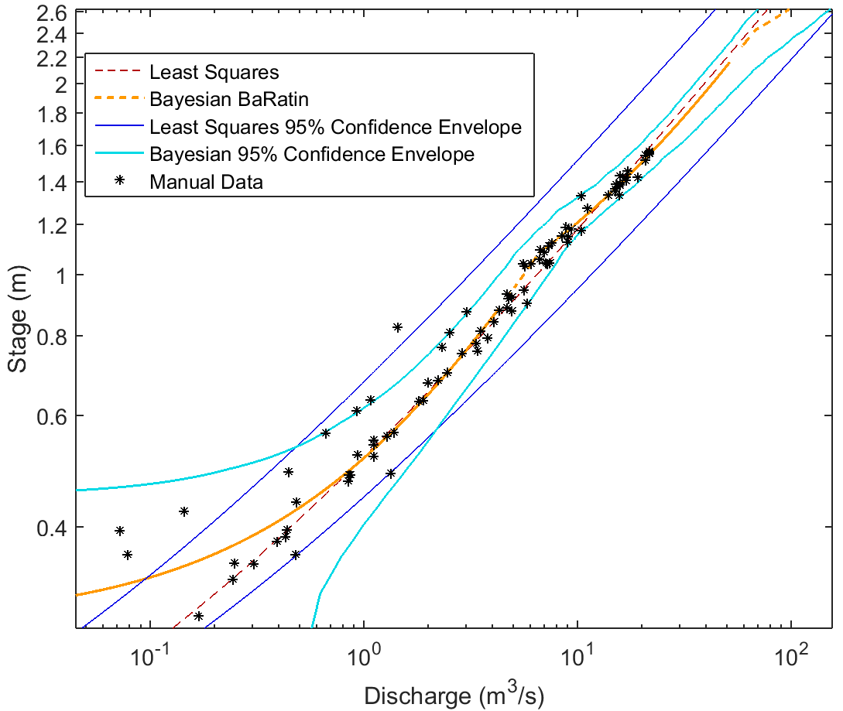
Log-Log View
Lyell Fork below Twin Bridges
Posterior Height of Section Break between Channel Control and Floodplain/Channel Control: 2.4 m
Height above which rating curve does not apply (ice jam): 2.5m
Posterior Height of Section Break between Section Control and Channel Control: 01.08 m

Slide 28
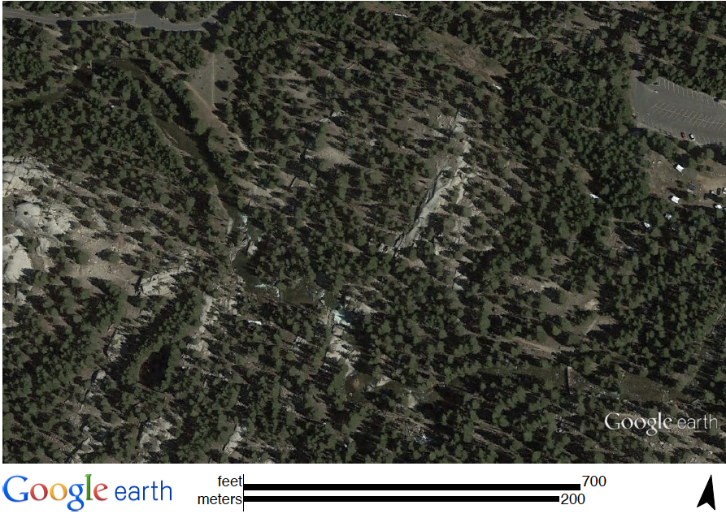
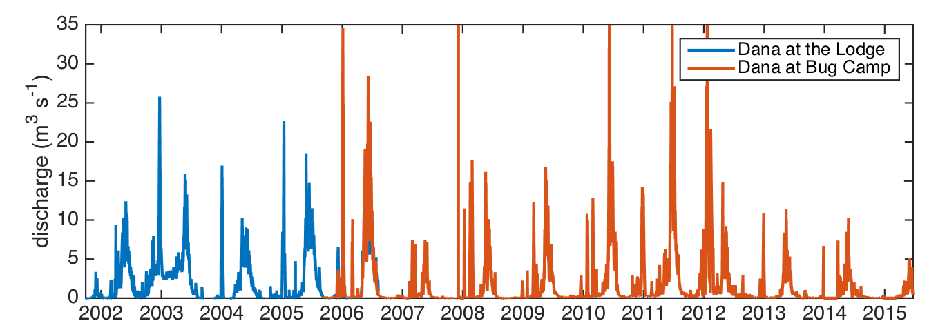
Dana Fork, Tuolumne Lodge and Bug Camp
Latitude: 37.876 Longitude: -119.333
Datum: NAD83
Elevation: 2800 m
Bug Camp site (stilling tube)
Lodge site (anchor)
Latitude: 37.877
Longitude: -119.338
Datum: NAD83
Elevation: 2640 m
bridge

Slide 29
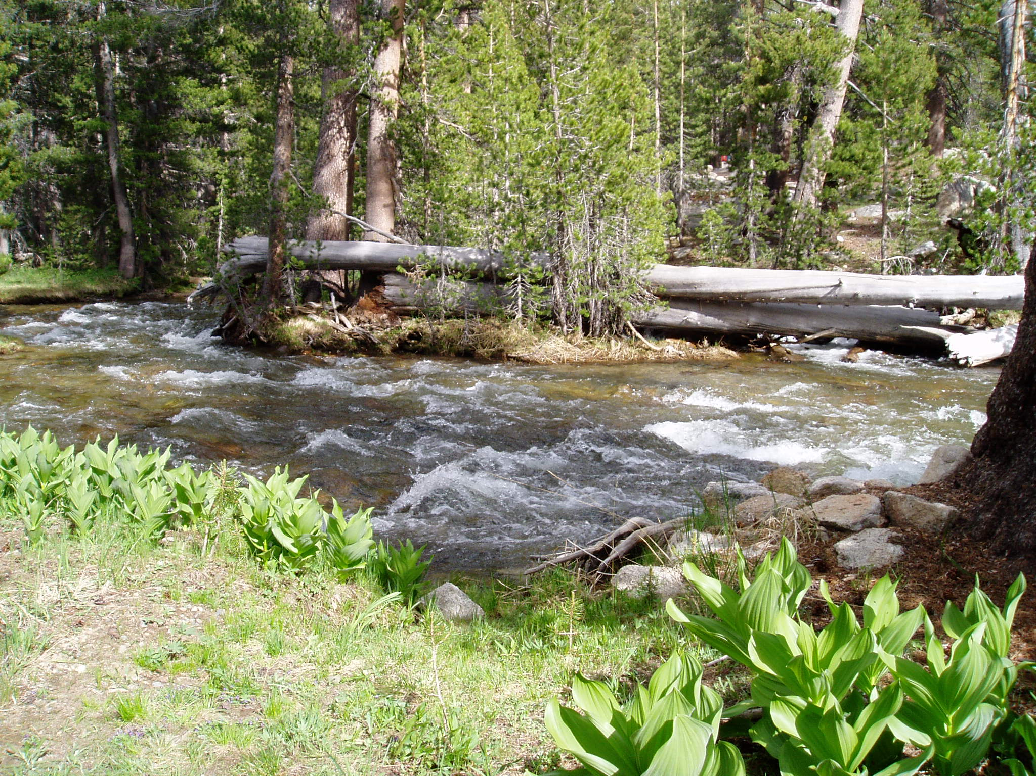
Dana Fork near Tuolumne Lodge
River Right
Width used for Channel Control: 12.5m +- 5m
Width used for Section Control: 3m +- 1m
Maximum height of measured stage: 1.4m
Height of Section Break between Section Control and Channel Control: 0.5 +- 0.2m
Instrument
Note significantly different scales for x and y axes.

Slide 30
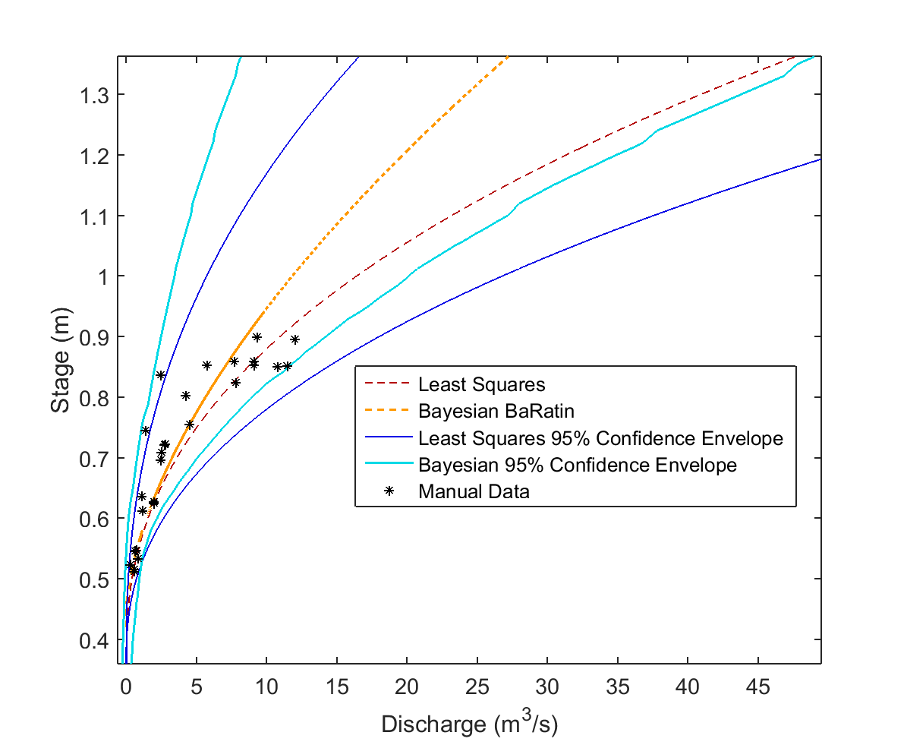
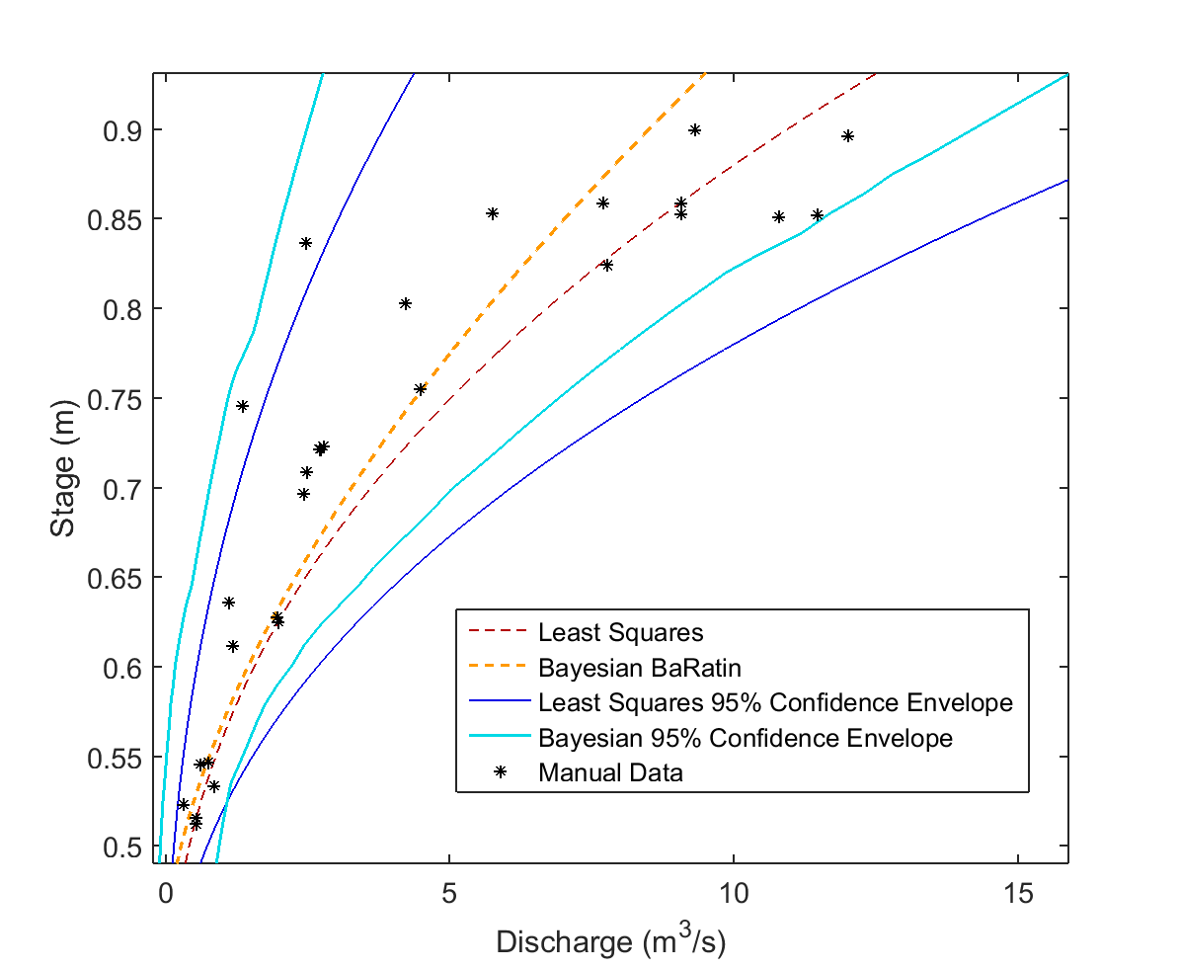
Dana Fork near Tuolumne Lodge
Least Squares (stage in ft, Q in cfs):
Q = (103.705*(H – 36.704)*0.03281)^2.355
BaRatin (stage in m, Q in cms):
0.456733m =< H
Q = 31.249*(H –0.4419)^1.6651
H < 0.456733m
Q =4.0361*(H –0.421)^1.4915
Posterior Height of Section Break between Section Control and Channel Control: 0.46 m

Slide 31
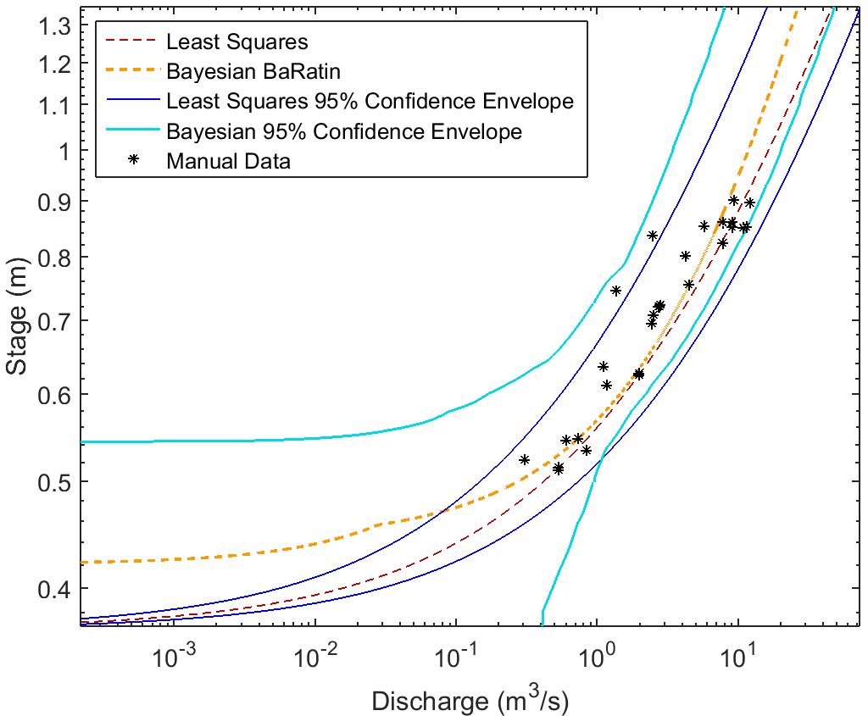
Log-Log View
Dana Fork near Tuolumne Lodge
Posterior Height of Section Break between Section Control and Channel Control: 0.46 m

Slide 32
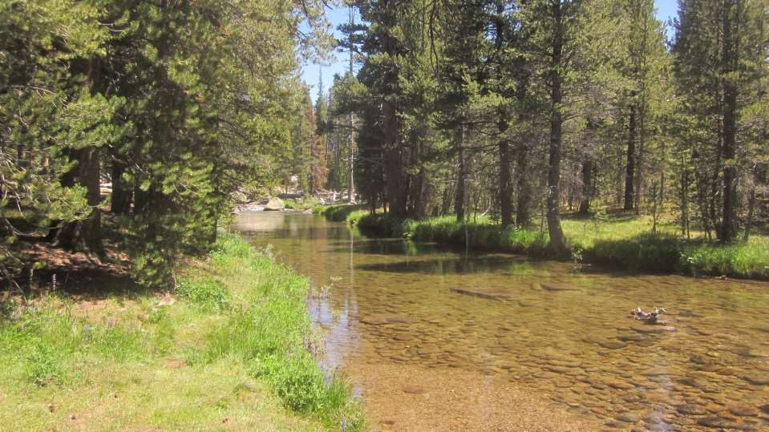

Dana Fork at Bug Camp
Flow
Staff plate installed 2012
corded Solinst (Silver model) inside stilling tube, installed 2006
Photo: 7/16/2015
Flow

Slide 33

Dana Fork at Bug Camp
River Right
Width Used for Floodplain/Channel Control: 15 m +- 5m
Width used for Channel Control: 12.7 m +- 5m
Height of Section Break between Channel Control and Floodplain/Channel Control: 0.9 m +- 0.2m
Width used for Section Control: 6.5 +- 1m
Height of Section Break between Section Control and Channel Control: 0.32 m +- 0.2m
Instrument
Note significantly different scales for x and y axes.
Floodplain
Channel
Flow
Slope: 0.033 m/m

Slide 34


Dana Fork at Bug Camp
Least Squares (stage in ft, Q in cfs):
Q = 68.09*(H –0. 5)^2.5
BaRatin (stage in m, Q in cms):
0.976552m < H
Q = 41.69*(H – 0.79033)^1.692
0.357608m < H < 0.976552m
Q = 37.16*(H – 0.2854)^1.6395
H < 0.357608m
Q =8.822*(H – 0.2066)^1.5183
Posterior Height of Section Break between Channel Control and Floodplain/Channel Control: 0.98 m
Posterior Height of Section Break between Section Control and Channel Control: 0.36 m
Posterior Height of Section Break between Section Control and Channel Control: 0.36 m

Slide 35

Log-Log View
Dana Fork at Bug Camp
Posterior Height of Section Break between Channel Control and Floodplain/Channel Control: 0.98 m
Posterior Height of Section Break between Section Control and Channel Control: 0.36 m

Slide 36

Dana Fork at Bug Camp
Flow
Instrument location
Dana near Bug Camp, 26 July 2003
Substantial uncertainty exists in the rating curve at the lodge location (see confidence intervals). Recommended to use the Bug Camp location data when possible.

Slide 37


Tuolumne at Highway 120
Highway 120
Staff gauge and instrument location
Downstream section control
Dana Fork
Latitude: 37.876
Longitude: -119.355
Datum: NAD83
Elevation: 2600 m
Lyell Fork

Slide 38


Tuolumne River at Highway 120
Flow
Corded pressure transducer, installed in 2006
Staff gauge, installed in 2006
Flow
Original install in 2001, anchored solinst and/or Seabird at the base of this abutment.

Slide 39


Tuolumne River at Highway 120
Upstream of the bridge, photo taken 23 September 2003
Flow
Downstream of the bridge
Flow

Slide 40
Tuolumne River at Highway 120
Width Used for Floodplain/Channel Control: 45 m +- 5m
River Right
Instrument #2
Width used for Channel Control: 36 m +- 5m
Width used for Section Control: 22 m +- 2m
Height of Section Break between Channel Control and Floodplain/Channel Control: 2.48 m +- 0.2m
Height of Section Break between Section Control and Channel Control: 1 m +- 0.2m
Note significantly different scales for x and y axes.
Instrument #1
Slope: 0.0405 m/m

Slide 41


Height above which rating curve does not apply (ice jam): 2.5 m
Tuolumne River at Highway 120
Least Squares (stage in cm, Q in cfs):
Q = 0.188488*(H – 70)^1.75063
BaRatin (stage in m, Q in cms):
0.764609m < H <= 2.499m
Q = 18.007*(H – 0.7169)^1.713
H < 0.764609m
Q = 34.099*(H – 0.7460)^1.468
Posterior Height of Section Break between Channel Control and Floodplain/Channel Control: 2.5 m
Posterior Height of Section Break between Section Control and Channel Control: 0.76 m
Posterior Height of Section Break between Section Control and Channel Control: 0.76 m

Slide 42

Log-Log View
Tuolumne River at Highway 120
Height above which rating curve does not apply (ice jam): 2.5 m
Posterior Height of Section Break between Channel Control and Floodplain/Channel Control: 2.5 m
Posterior Height of Section Break between Section Control and Channel Control: 0.76 m

Slide 43


Tuolumne River at Highway 120
Photo on 29 July 2015; red shows gravel bar section control. 16:00 on 29 July 2015: Gage height of zero flow 2.79 ft – 0.86 ft = 1.93 ft
The rating curve at this location has greater confidence than at many of the other sites.

Slide 44


Delaney Creek
Latitude: 37.883
Longitude: -119.381
Datum: NAD83
Elevation: 2600 m
Trail to Glen Aulin
Tuolumne River
Trail site
(stilling tube)
Meadow site (stilling tube)
Meadow site only is available at this time. Notice frequency of ice jams.

Slide 45

Delaney Creek
River Right
Maximum Stage Depth for which Rating Curve and Confidence Bounds are valid: 1.2 m
Width used for Section Control: 6 m +- 1m
Note significantly different scales for x and y axes.
Instrument
Instrument
Floodplain
Channel
Flow
Slope: 0.00422 m/m

Slide 46


Height above which rating curve does not apply (ice jam): 1.2 m
Delaney Creek
Least Squares (stage in cm, Q in cfs):
Q = 0.0037*(H – 6)^2.3618
BaRatin (stage in m, Q in cms):
1.07m < H <= 1.2m
Q = 41.69*(H – 0.79033)^1.692
0.369561m < H < 1.07m
Q = 6.157*(H – 0.19283)^1.685
H < 0.369561m
Q = 2.903*(H – 0.12934)^1.525
Posterior Height of Section Break between Channel Control and Floodplain/Channel Control: 1.07 m
Posterior Height of Section Break between Section Control and Channel Control: 0.37 m
Posterior Height of Section Break between Section Control and Channel Control: 0.37 m

Slide 47

Log-Log View
Delaney Creek
Height above which rating curve does not apply (ice jam): 1.2 m
Posterior Height of Section Break between Channel Control and Floodplain/Channel Control: 1.07 m
Posterior Height of Section Break between Section Control and Channel Control: 0.37 m

Slide 48


Budd Creek
Latitude: 37.873
Longitude: -119.382
Datum: NAD83
Elevation: 2600 m
Culvert under Highway 120
Lower site
(anchor)
Upper site
(stilling tube)

Slide 49
Budd Creek
Downstream instrument (concrete anchor)
Highway 120
culvert
Staff plate
Upstream instrument (stilling tube)
stream
Budd Creek has a long record and two instruments, but due to a shifting channel bed, backwater effects from the culvert, and shifts in instrument location, the rating curve has high uncertainty. We used least squares (as in Rantz et al. 1982) and do not provide 95% confidence values for this site.

Slide 50

Budd Creek
Upstream of culvert
Flow
Stilling tube
Staff plate, used as stage datum
The upstream site serves as the principal record, except in the case of known ice jams or backwater affects. Occasionally water levels rise above the top of the culvert, therefore initiating higher recorded stage values which may not agree with rating curve estimated discharge values. In the event of backwater or ice jam events the downstream record was used.
The upstream site has a corded Solinst pressure transducer located inside of a stilling tube. Just downstream of the stilling tube is a white staff plate designed to standardize periodic manual stage measurements. These manual stage measurements were used to correct instrument drift in the Solinst pressure transducer.
Backwater from the culvert and changing downstream sediment make this site not work well with the BaRatin method.

Slide 51



Budd Creek
Downstream of culvert
Flow
Flow
Flow
Flow
The downstream Solinst pressure transducer is located in concrete anchor. The anchor occasionally is moved during high flows, thus requiring an estimated offset in order to provide a consistent record. The upstream of culvert site therefore provides a preferred record for Budd Creek.

Slide 52

Budd Creek
Rating curve for Budd Creek upstream of culvert. Q=.182(stage-6.5)^ 1.3139. The rating curve for downstream of the culvert is 0.0245*(stage -10).^1.7951.

